Slide 1

Lecture 5: fluorescent proteins; genetically encoded sensors and actuators
luke@sjulsonlab.org

Slide 2
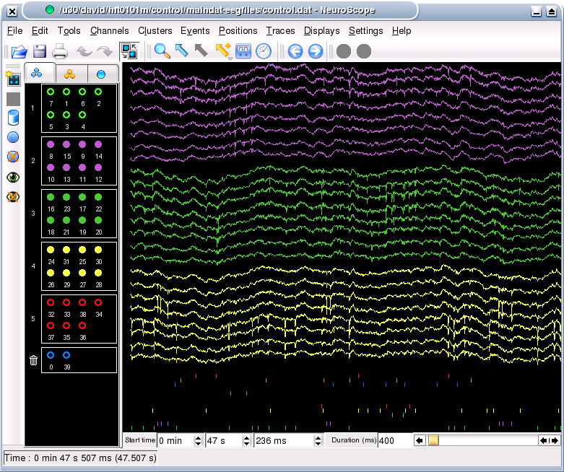
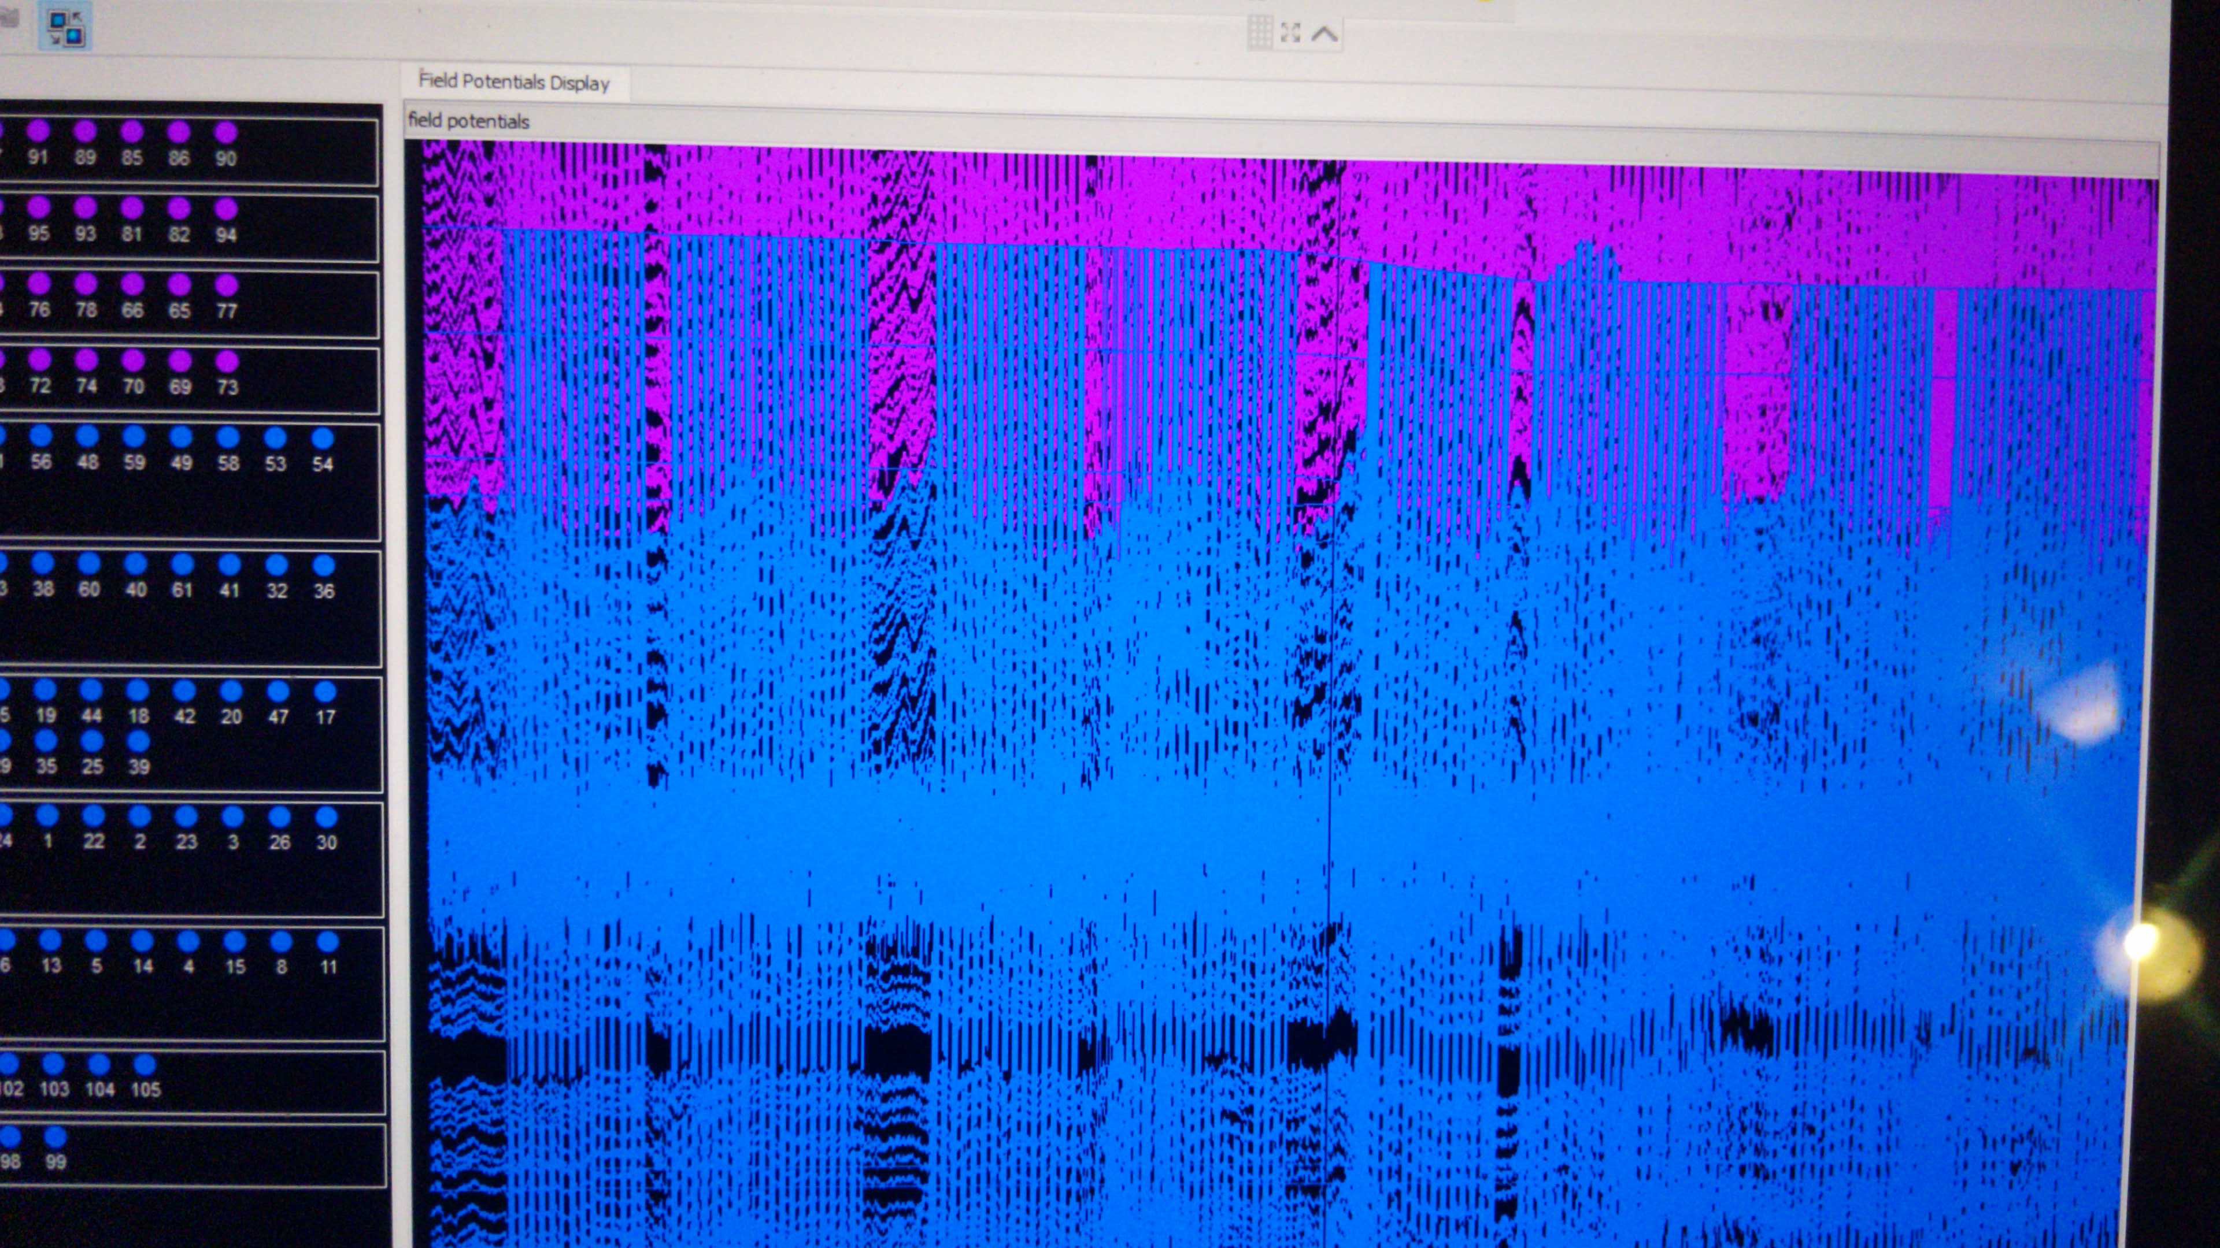
Review of lecture 2
The failure rate of spinning disk hard drives is 100%!!

Slide 3
Outline
Sensors
Bioluminescence vs fluorescence
Overview of fluorescent proteins
Mechanisms to couple cellular phenomena to changes in fluorescence signal
Genetically encoded indicators: calcium, voltage, etc.
Actuators
Optogenetic
Photocaged molecules
Opsins
LOV-Jalpha interactions
CALI
Chemogenetic
Metabotropic: DREADDs
Ionotropic: PSAM/PSEM, GluCl

Slide 4
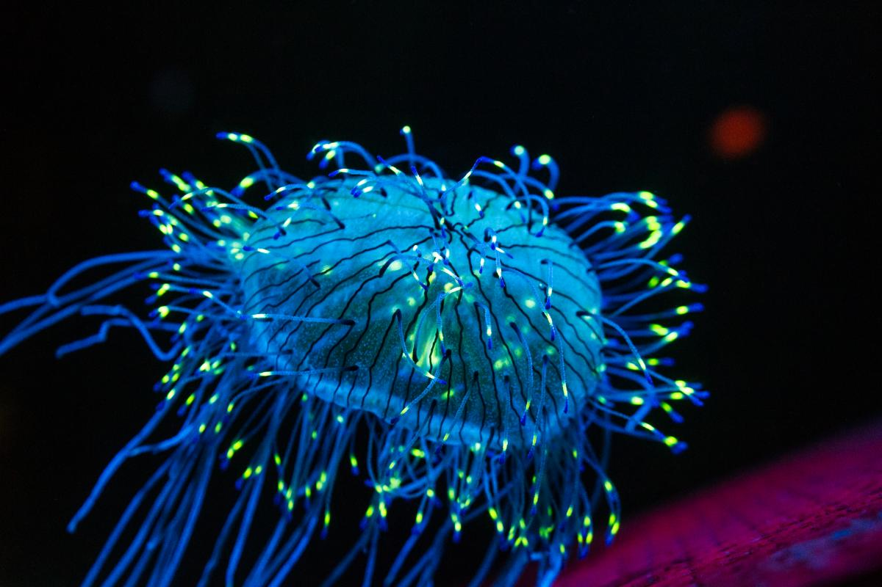
Bioluminescence generates photons

Slide 5
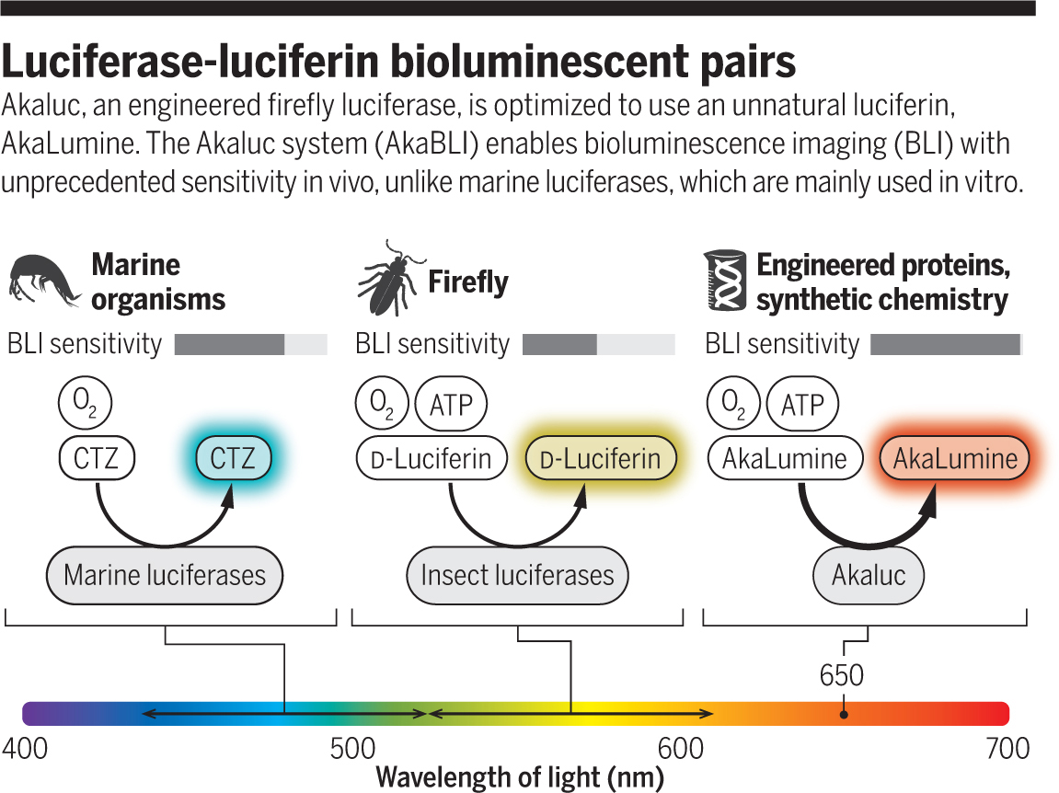
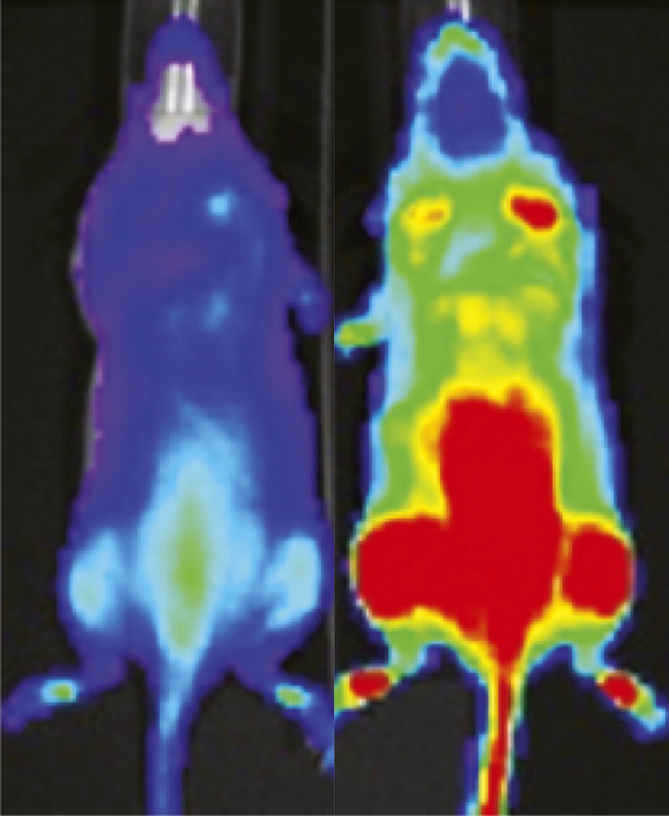
Luciferases oxidize luciferins to generate photons
https://newscenter.lbl.gov/2011/02/10/firefly-glow-for-hydro-peroxide/
https://science.sciencemag.org/content/359/6378/868/tab-figures-data

Slide 6
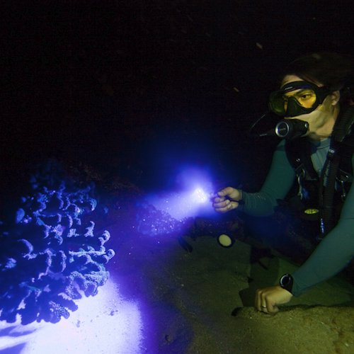
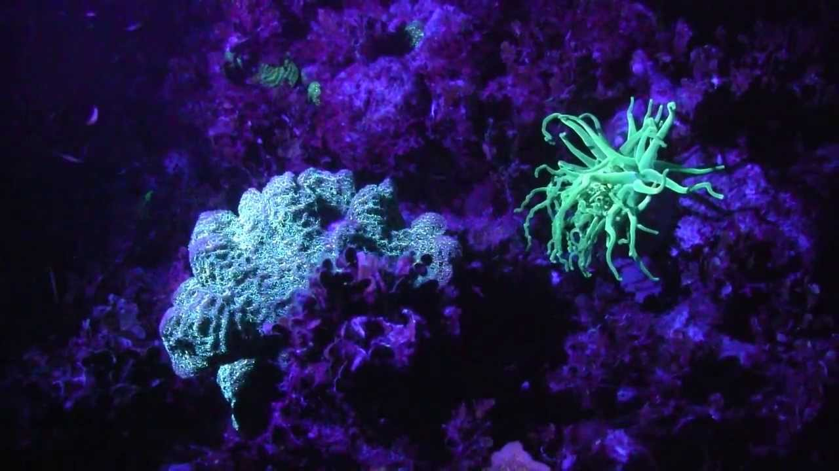
Fluorescence: excitation by photons and emission of lower-energy photons
Fluorescence, not flourescence

Slide 7
Outline
Sensors
Bioluminescence vs fluorescence
Overview of fluorescent proteins
Mechanisms to couple cellular phenomena to changes in fluorescence signal
Genetically encoded indicators: calcium, voltage, etc.
Actuators
Optogenetic
Photocaged molecules
Opsins
LOV-Jalpha interactions
CALI
Chemogenetic
Metabotropic: DREADDs
Ionotropic: PSAM/PSEM, GluCl

Slide 8
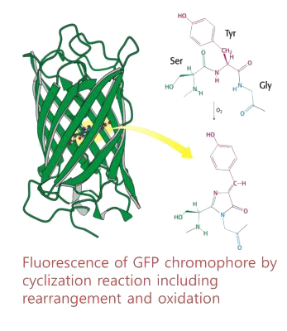
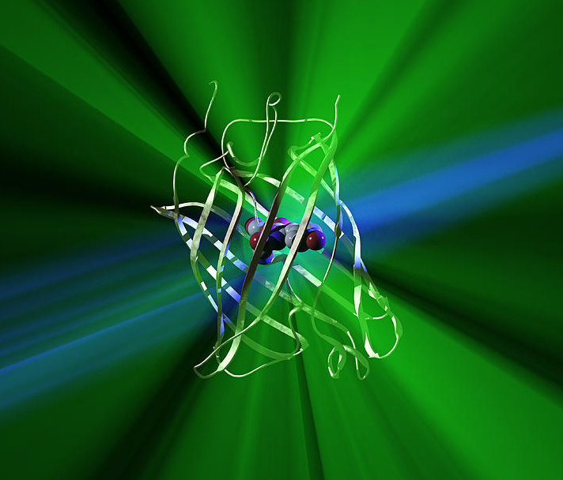
Side chains inside the GFP β-barrel react to form the chromophore
The β–barrel shields the chromophore
FPs photobleach less than most fluorescent dyes

Slide 9
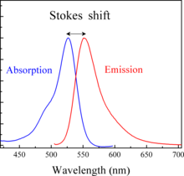
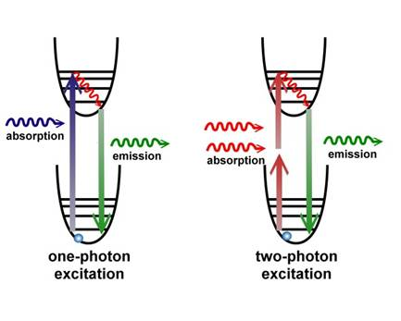
Stokes shift: the difference between excitation and emission wavelengths

Slide 10
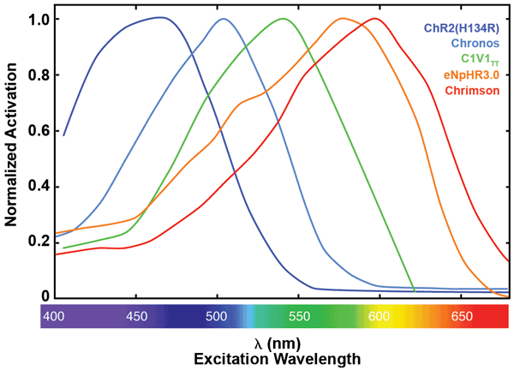
Spectra encountered in neuroscience are usually asymmetrical because high and low energy are different
Fluorescence
Opsin action spectrum
High
energy
Low
energy

Slide 11
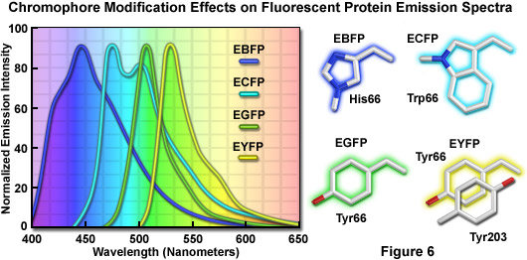
Mutations enable changes in excitation and emission spectra

Slide 12
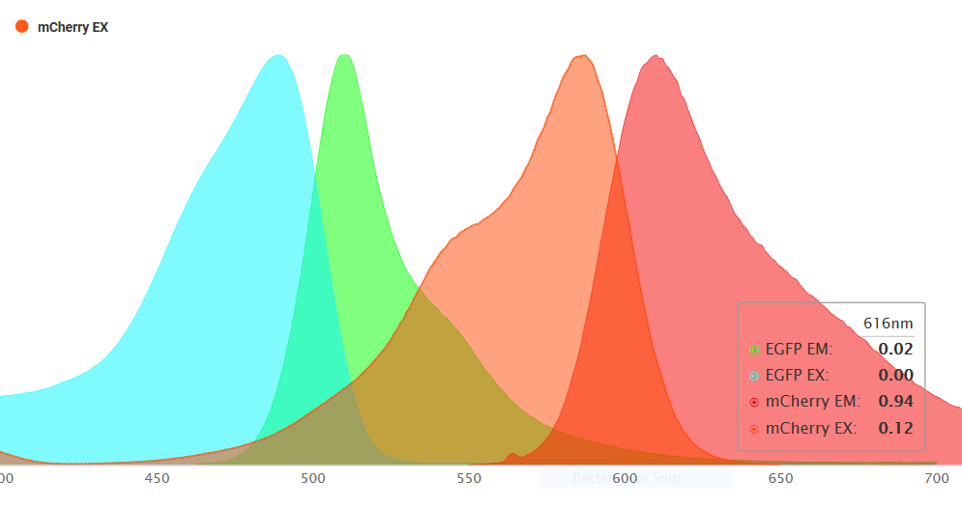
EGFP and mCherry represent the two main families of FPs
Aequoria victoria GFP: EGFP, BFPs, CFPs, YFPs, mCitrine
Discosoma DsRed: “RFP”, the mFruits (mCherry, tdTomato, etc.) but not mCitrine
GFP or DsRed antibodies generally cross-react with all family members
Highly recommended site with database of all fluorescent proteins and dyes: fpbase.org

Slide 13
Cellular localization is important!!
Plasma membrane (e.g. ChR2-EYFP)
Transmembrane proteins expressed at lower levels (so >10X dimmer)
Labels processes >> soma
Usually impossible to tell which cells are expressing it
Cytoplasmic (e.g. ChR2 – P2A – EYFP)
Labels processes << soma
If labeling is dense, may require confocal/two-photon to see which cells are positive
Nuclear (e.g. ChR2 – P2A – nls-dTomato)
“nls” – nuclear localization sequence. At high expression levels it won’t be restricted to the nucleus
Concentrating the fluorescence in the nucleus makes it very bright (i.e. sensitive to detect low expression levels)
This is what most people in neuroscience should be using

Slide 14
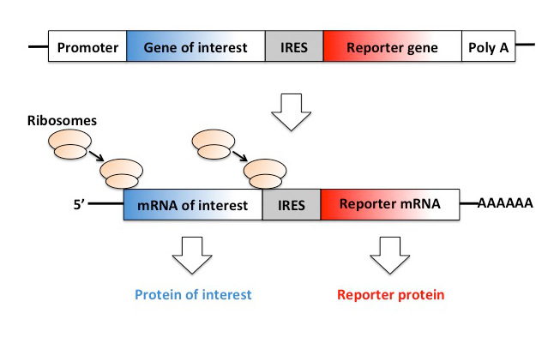
IRES and 2A – viral tricks to make separate proteins from one gene
e.g. ChR2-IRES-EGFP or hM4Di-P2A-nls-dTomato
IRES: internal ribosome entry site
2nd translation begins at the IRES
Both protein sequences unchanged
Both blue and red proteins are expressed at lower than normal levels
IRES adds ~1kb length
2A: viral “cleavage* sequence”
Ribosome translates both proteins in one pass without forming peptide bond (*so not actually cleavage)
Proteins are made in exact 1:1 ratio
Proteins get a few extra AAs
Small size fits in viral vectors
Multiple 2A’s (P2A, T2A, etc.) – not all have efficient cleavage

Slide 15
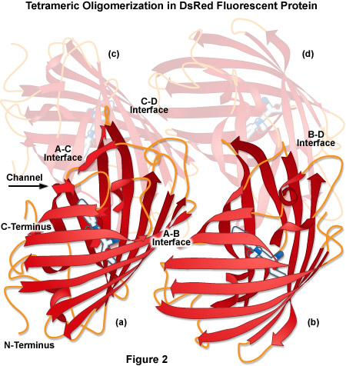
Fluorescent proteins are generally multimeric
DsRed is tetrameric
mFruits are monomeric (“m”) or tandem dimer (“td”) derivatives of DsRed (e.g. mCherry, tdTomato)
GFP is weakly dimeric (but A206K disrupts)
This becomes problematic when you fuse FPs to another protein
mCherry is NOT fully monomeric
ChR2-mCherry and hM4Di-mCherry fusions are not as good as their EYFP counterparts

Slide 16
For any given FP construct: what do you actually need to know?
Excitation/emission wavelengths (what color is it?)
Where is it localized? Membrane vs cytoplasm vs nuclear
How sensitive is it to fixation or tissue clarification?
What antibodies to use if it isn’t visible in histology?
GFP vs DsRed/”RFP”
Is it monomeric/dimeric/tetrameric?
mCherry is NOT fully monomeric! mCherry fusions can be problematic.
Relevant biophysical parameters:
Brightness = extinction coefficient * quantum yield
Two photon absorption cross section: not same as extinction coefficient!
Tendency to photobleach: unfortunately, no standardized way to measure

Slide 17
Note: there are fluorescent proteins that are not GFP-like
Here “GFP-like” means having a β-barrel structure shielding the chromophore
Notable exception 1: Near-infrared fluorescent proteins
miRFP670nano, iRFP720 – developed by Vlad Verkhusha’s lab
These are spectrally distinct from mCherry/tdTomato and are compatible with the far-red filter set on many fluorescence microscopes
We are using these to prevent interference with fiber photometry
Notable exception 2: rhodopsin-based fluorescent proteins
Voltage reporters: Arch, QuasAr
Notable exception 3: proteins that bind exogenous fluorescent molecules
Voltage reporters: Voltron

Slide 18
Outline
Sensors
Bioluminescence vs fluorescence
Overview of fluorescent proteins
Mechanisms to couple cellular phenomena to changes in fluorescence signal
Genetically encoded indicators: calcium, voltage, etc.
Actuators
Optogenetic
Photocaged molecules
Opsins
LOV-Jalpha interactions
CALI
Chemogenetic
Metabotropic: DREADDs
Ionotropic: PSAM/PSEM, GluCl

Slide 19
How do we couple a cellular phenomenon to changes in fluorescence signal?
Chromophore protonation/deprotonation
Förster Resonance Energy Transfer (FRET)
Also called Fluorescence Resonance Energy Transfer

Slide 20
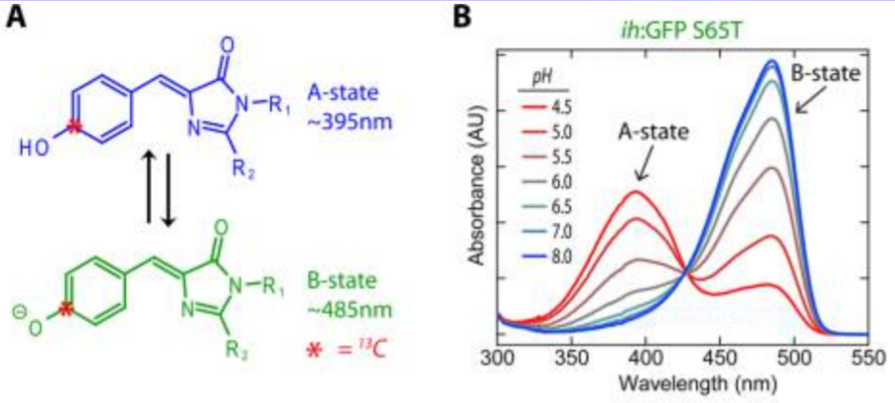
The GFP chromophore is in equilibrium between protonated and deprotonated states
Normally, the chromophore in EGFP is in the deprotonated state (B) because the β–barrel shields it from water

Slide 21
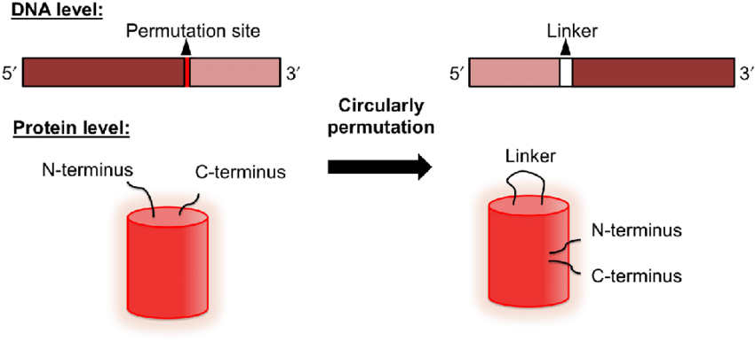
Circular permutation of fluorescent proteins
The original N- and C-termini are far away from the chromophore
The new N- and C-termini are right next to the chromophore

Slide 22
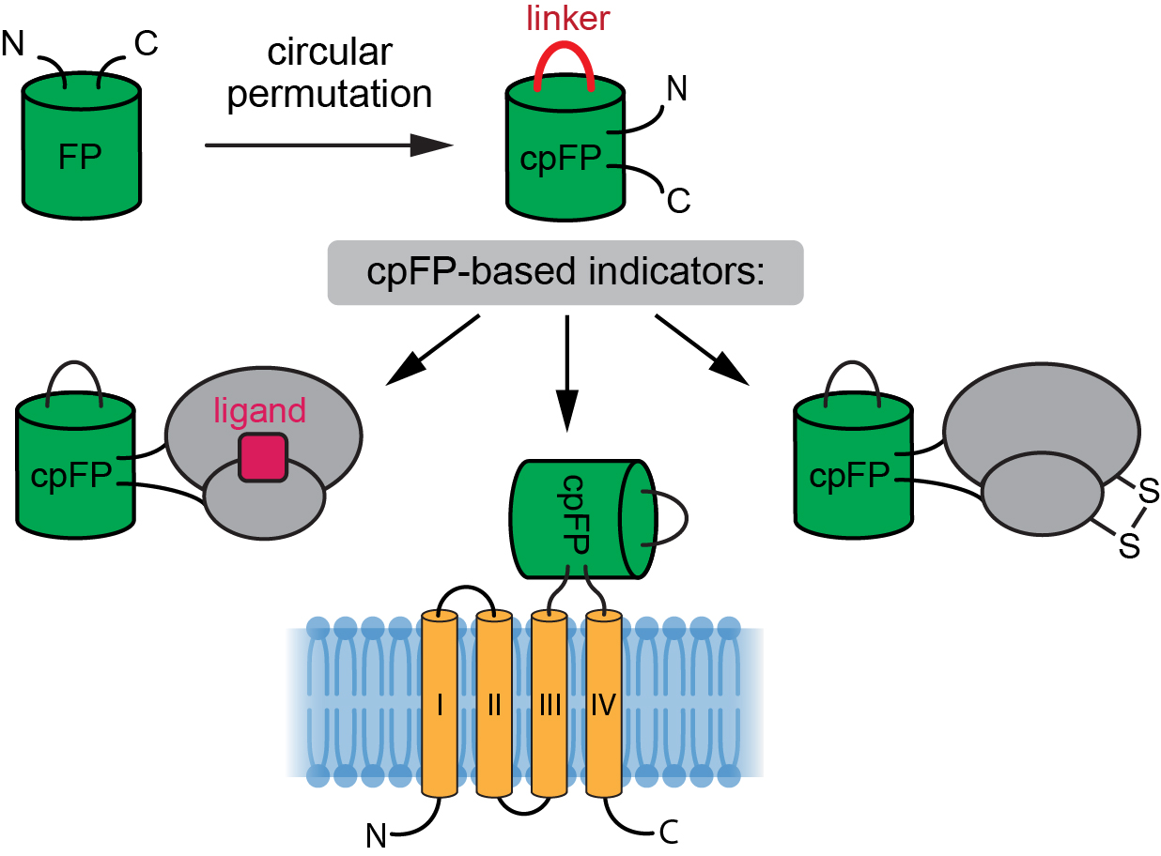
Circular permutation opens the β–barrel and exposes the chromophore to water, protonating the chromophore
Open: protonated, low fluorescence
Closed: deprotonated, high fluorescence
Calcium binding: GCaMP, RCaMP, XCaMPs, etc.
G-protein coupled receptors: dLight, GRABDA, etc
Voltage-sensitive proteins: ASAP, ArcLight

Slide 23
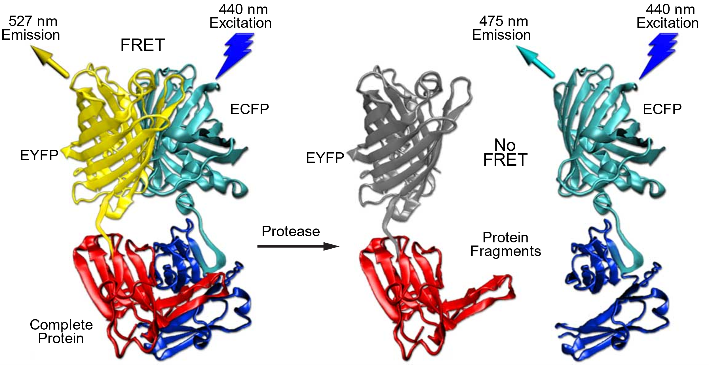
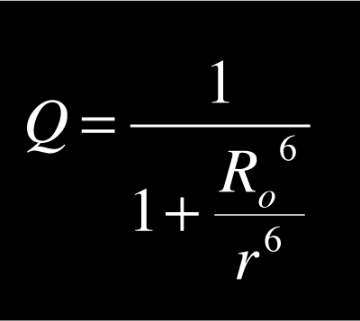
Fӧrster Resonance Energy Transfer (FRET)
r⁶, not r²!!
Also called Fluorescence Resonance Energy Transfer
Conceptually: ECFP emits blue photons that excite EYFP
If far apart, exciting ECFP yields a blue photon
If close together, EYFP absorbs the blue photon, and exciting ECFP yields only a yellow photon
The actual mechanism is more complicated than that

Slide 25
Outline
Sensors
Bioluminescence vs fluorescence
Overview of fluorescent proteins
Mechanisms to couple cellular phenomena to changes in fluorescence signal
Genetically encoded indicators: calcium, voltage, etc.
Actuators
Optogenetic
Photocaged molecules
Opsins
LOV-Jalpha interactions
CALI
Chemogenetic
Metabotropic: DREADDs
Ionotropic: PSAM/PSEM, GluCl

Slide 26
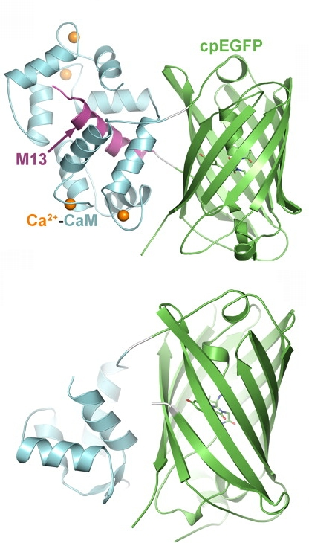
GCaMP (and related GECIs)
GECI: genetically encoded calcium indicator
The M13 peptide is toxic to cells, especially during development
Ca++ buffering is not the mechanism of GCaMP toxicity
Less toxic variants now exist (GCaMP-X and the XCaMPs)
Test serial dilutions of each new AAV batch
Different GCaMP variants have different baseline fluorescence
GCaMP has multiple Ca++ binding sites with cooperative binding
Nonlinear, limited dynamic range
Different GCaMP variants exist with different on and off kinetics

Slide 27
GCaMP nonlinearity, kinetics

Slide 28
GCaMP nonlinearity, kinetics

Slide 29
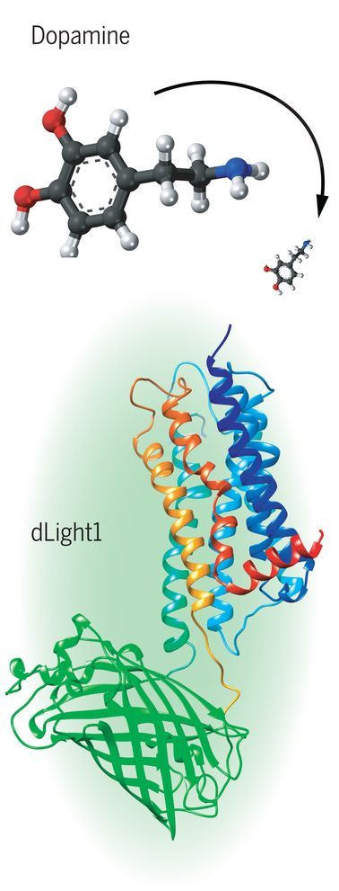
GPCR-based reporters
GPCR: G-protein coupled receptor
dLight: D1 dopamine receptor
GRABDA: D2 dopamine receptor
Now available in red versions
Sensors available for serotonin, norepinephrine, opioids, etc.
~400 non-olfactory GPCRs in genome

Slide 30
Genetically encoded voltage indicators (GEVIs)
Making GEVIs is much harder than GECIs
Voltage only detectable at the membrane, not in the cytoplasm
Voltage sensing is a lot more complicated than calcium binding
Voltage sensors are more likely to perturb normal cellular function
Harder to screen GEVI candidates in vitro
Imaging GEVIs is much harder than GECIs
Fluorophore is membrane-localized, not cytoplasmic
Signal comes mostly from processes, not soma. Each pixel contains membrane from many cells
Signals are much shorter in duration – requires high imaging speeds and very strong signal
Membrane potential is more strongly correlated between different cells than spikes are – hard to tell which cell the signal is from

Slide 31
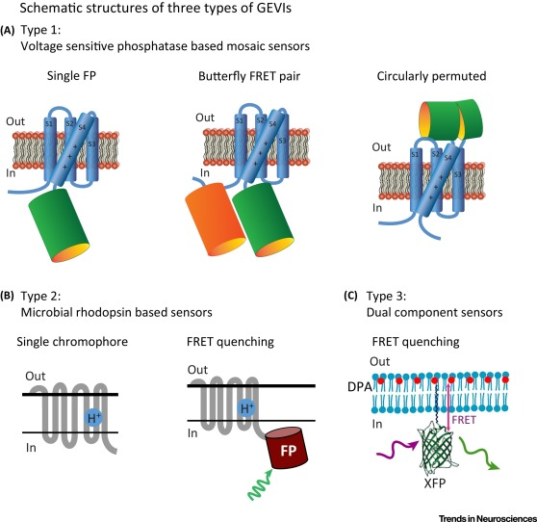

Slide 34
Outline
Sensors
Bioluminescence vs fluorescence
Overview of fluorescent proteins
Mechanisms to couple cellular phenomena to changes in fluorescence signal
Genetically encoded indicators: calcium, voltage, etc.
Actuators
Optogenetic
Photocaged molecules
Opsins
LOV-Jalpha interactions
CALI
Chemogenetic
Metabotropic: DREADDs
Ionotropic: PSAM/PSEM, GluCl

Slide 35
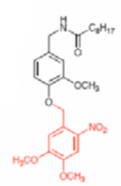
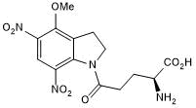
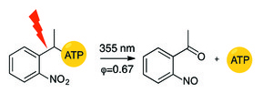
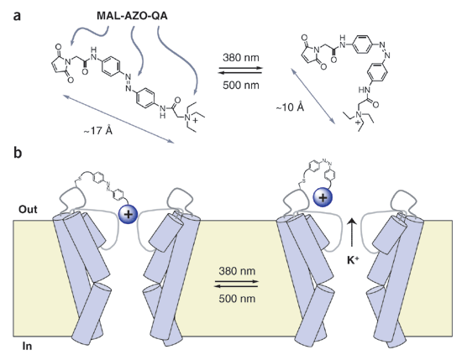
Photocaged molecules
Caged glutamate + endogenous receptors
Caged ATP +
P2X₂ receptor
Caged capsaicin + TRPV1 receptor
MAL-AZO-QA +
modified K+ channel
The key idea: proteins can’t sense light, so an exogenous light-sensitive cofactor is required

Slide 36
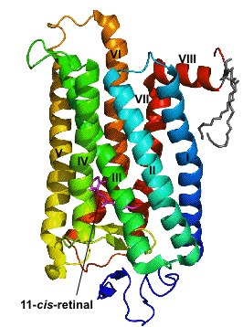
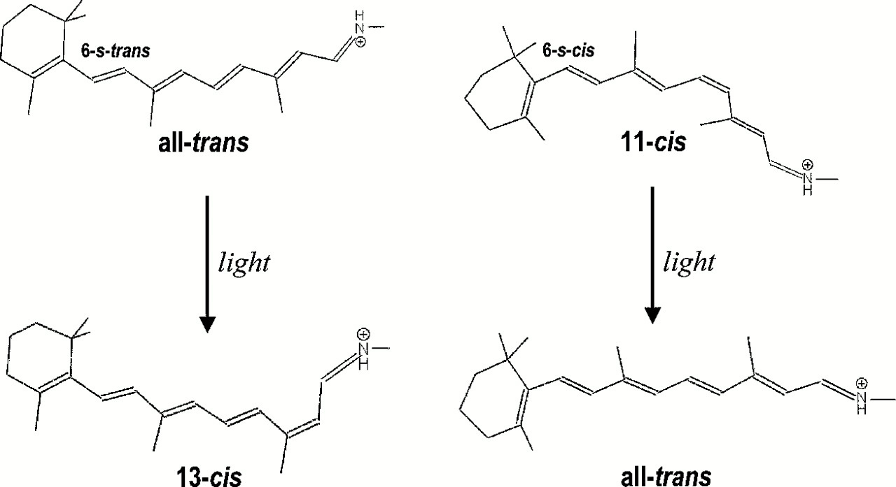
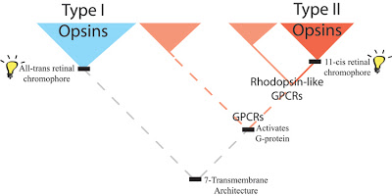
Opsins: addition of cofactor is not (always) required
But how do you isomerize it back?
http://evolutionarynovelty.blogspot.com/2008/12/opsins-amazing-evolutionary-convergence.html

Slide 37
Different opsins re-isomerize their chromophore differently
Metazoan opsins
Gi-coupled family: vertebrate visual opsins
Chromophore dissociates from protein after absorbing photon. Is re-isomerized by a special biochemical pathway only in the retina
Gq-coupled family: invertebrate visual opsins, mammalian melanopsin
Chromophore does not dissociate. Re-isomerizes after absorption of second photon at different wavelength
Microbial opsins
Ion pumps and channels: bacteriorhodopsin, halorhodopsin, channelrhodopsin, etc.
Mostly used for photosynthesis
Chromophore does not dissociate from protein. Re-isomerizes in dark

Slide 38
Metazoan opsins
“OptoXRs” – mutant rhodopsins available in Gs-, Gi-, and Gq-coupling versions
Wild-type rhodopsin (Gi-coupled) does suppress presynaptic vesicle release
Have not been used much
Chromophore does not regenerate, so runs down over time
Anecdotal: too light sensitive, activated by room light
Lamprey parapinopsin: a bistable Gi-coupled opsin for silencing presynaptic terminals
Blue light activates it (suppressing vesicle release)
Green light inactivates it
Bruchas lab had a poster at SfN two years ago…

Slide 39
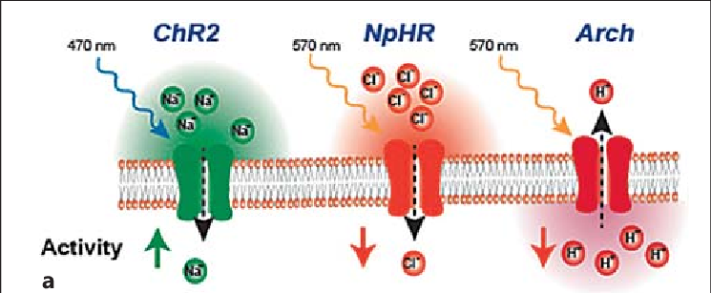
Microbial opsins
Channels
Cation (excitatory): ChR2, ReaChR and ChrimsonR (red-shifted)
Low light sensitivity, small unitary conductance
Anion (inhibitory):
Artificial: iChloC, iC++, SwiChRca, etc. – low conductance
Natural: GtACRs - high conductance
Pumps
Chloride (inhibitory): Halo (aka NpHR), Jaws (red-shifted)
Proton (inhibitory): Arch
Great resource: https://www.addgene.org/guides/optogenetics/

Slide 40
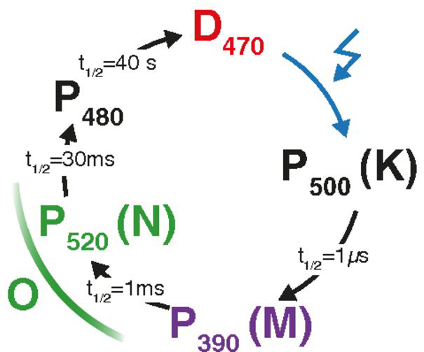
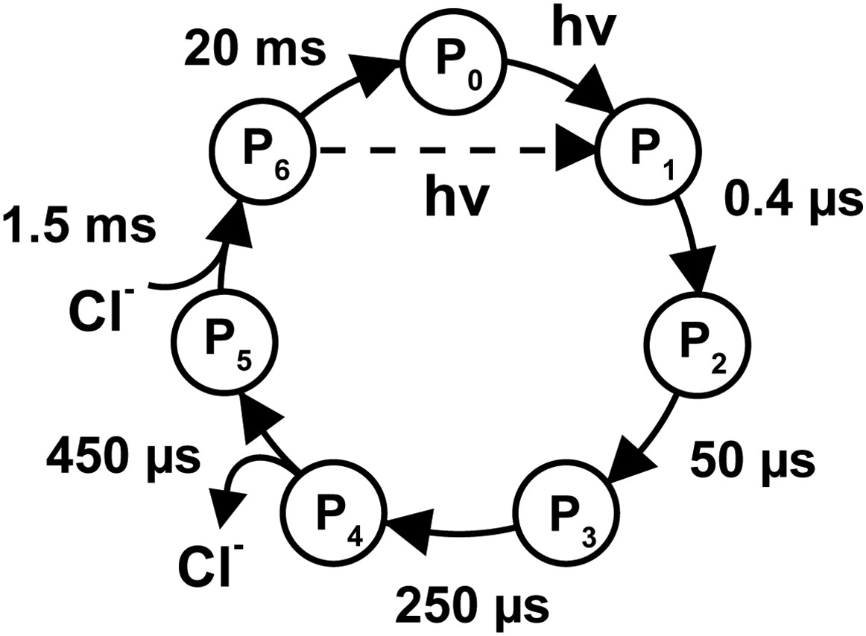
Opsin photocycles
ChR2 (cation channel)
Halo (Cl- pump)
Kinetics
Channels: fast on, slow off
Pumps: fast on, fast off
Light sensitivity
Channels: one photon = many ions
Pumps: one photon = one ion
There is a tradeoff: faster off-kinetics means fewer ions per photon

Slide 41
Opsin currents are filtered light waveforms

Slide 42
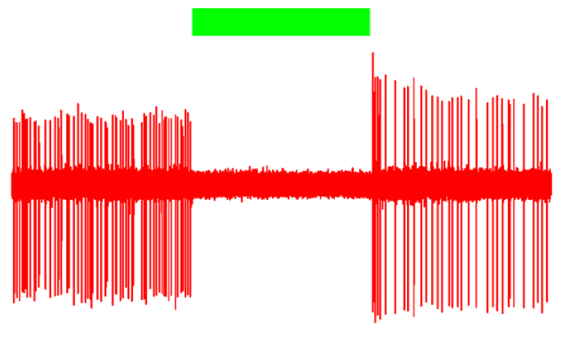
Exciting cells is easier than inhibiting them
Inhibition requires more light
Excitation: brief pulses Inhibition: constant illumination
Channels: many ions/photon Pumps: few ions/photon
Tissue heating becomes a factor
Inhibition is often incomplete
Post-inhibitory rebound
Worse with Halo (Cl-) than Arch (H+)
Pumps alter ion concentrations
Halo increases intracellular [Cl-]: GABA becomes excitatory
Arch increases intracellular pH: causes spontaneous vesicle release
GtACRs (high-conductance Cl- channels) are the most promising

Slide 43
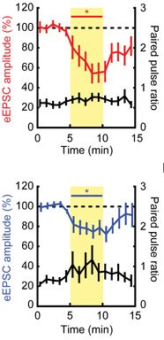
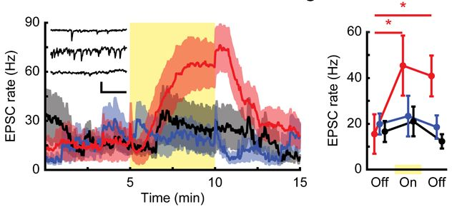
Inhibiting axon terminals with microbial opsins works, sort of
Arch
Halo
Neither Arch nor Halo blocks release completely
Arch causes increased rate of spontaneous release (of unclear significance)
GtACRs don’t suppress vesicle release at all
GtACRs suppress somatic APs but induce a single axonal AP on light initiation
Lamprey parapinopsin may be our savior…?
Mahn et al, Nat Neurosci 2016

Slide 44
Tips/caveats for opsins
All opsins are stimulated by short-wavelength light
Pulsed light can lead to entrainment
To inhibit part of cortex, stimulating its inhibitory neurons is more effective than inhibiting its excitatory neurons
Stimulation of axon terminals will cause retrograde spikes to propagate to the soma and everywhere else that cell projects
Optotagging is not trivial and can leads to lots of false positives!
Stujenske and Gordon paper with matlab toolbox for
light propagation and heating calculations:
https://www.ncbi.nlm.nih.gov/pubmed/26166563

Slide 45
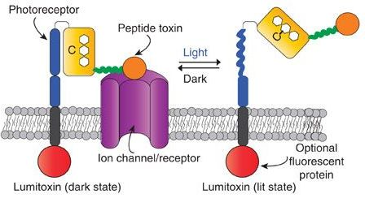
LOV-Jalpha: versatile light-sensitive protein domains
LOV-Jalpha used for many applications
Turns on in ~1 second, off kinetics variable
Lumitoxins: not widely used
Blue photon energy: 64 kcal/mol
LOV-Jalpha ΔΔG = 3.8 kcal/mol

Slide 46
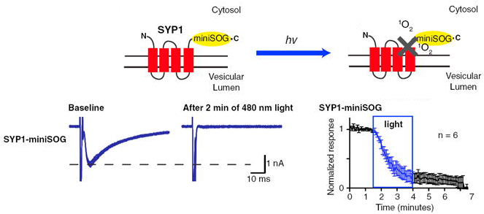
CALI: chromophore-assisted light inactivation
Opinion: CALI is probably underused in neuroscience
Lin et al., Neuron 2013

Slide 47
Outline
Sensors
Bioluminescence vs fluorescence
Overview of fluorescent proteins
Mechanisms to couple cellular phenomena to changes in fluorescence signal
Genetically encoded indicators: calcium, voltage, etc.
Actuators
Optogenetic
Photocaged molecules
Opsins
LOV-Jalpha interactions
CALI
Chemogenetic
Metabotropic: DREADDs
Ionotropic: PSAM/PSEM, GluCl

Slide 48
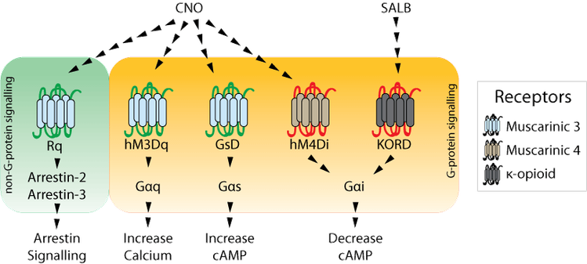
DREADDs: Designer Receptors Exclusively Activated by Designer Drugs
The theory: CNO is a pharmacologically inert compound that activates DREADDs and nothing else
The reality: the liver converts CNO to clozapine, which activates the DREADDs. Clozapine binds many receptors, but the dose required to activate DREADDs is very small
Mike Michaelides’s group has developed next-generation DREADD ligands that apparently are truly DREADD-selective at useful concentrations
Salvinorin-B: appears to be pharmacologically inert, has extremely short half-life
Anecdotes: some sources of salvinorin-B are contaminated with salvinorin-A, a hallucinogen
RUN CONTROLS!!
Strongly recommend: https://www.addgene.org/guides/chemogenetics/

Slide 49
DREADDs: Designer Receptors Exclusively Activated by Designer Drugs
KORD and hM4Di: activate Gi signaling, decrease cAMP
Activates GIRK K+ channels (in some cells), hyperpolarizing membrane
Inhibits presynaptic vesicle release: inhibits Ca++ channels and SNAREs
This is the main mechanism underlying behavioral effects
hM3Dq: activates Gq pathway, increases firing rates. Shown in grid cells to increase firing rates without disrupting grid structure.
Strongly recommend: https://www.addgene.org/guides/chemogenetics/

Slide 50
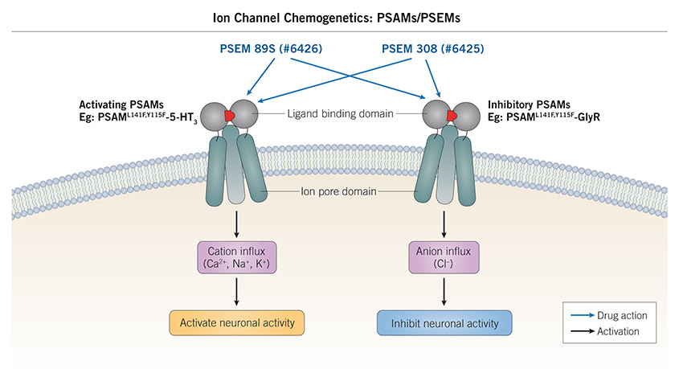
Ionotropic, available in both excitatory and inhibitory versions
First generation PSEM/PSAMs had low affinity, and PSEMs were not commercially available
New generation: activated by microdoses of varenicline or tropisetron, which are approved for use in humans

Slide 51
When to use optogenetics vs chemogenetics?
Optogenetics
Good for short periods, bad for >5-10 seconds at a time*
More equipment, animal requires tether
Best for small brain regions
Precise manipulations, at specific locations, task phases, etc.
Within-session manipulations enable within-subject expt design (e.g. compare activity +/- opto)
Broad generalization: takes longer to set up but can yield data that’s easier to interpret
Chemogenetics
Low temporal resolution, good for entire behavioral sessions
Less equipment, animals move freely, more animals simultaneously
Equally good for large or small
Less precision but activity patterns are not grossly non-physiological
Negative control animals necessitate between-subject expt designs
Broad generalization: faster to set up but usually requires more animals, analysis can be more difficult

Slide 52
Alternatives to opto/chemo-genetics
Both are bad on long timescales. hM4Di has been shown to desensitize and stop working after ~24-48 hours if CNO is put in drinking water
Lesions, AAV-tetanus toxin, diphtheria toxin
NaChBac (excitatory) or Kir2.1 (inhibitory) are leaky channels that can be expressed under doxycycline regulation and used to increase or decrease excitability of cells for periods of days-weeks
DREADDs should not be conceptualized as excitatory and inhibitory. They have many complex effects

Slide 53
Outline
Sensors
Bioluminescence vs fluorescence
Overview of fluorescent proteins
Mechanisms to couple cellular phenomena to changes in fluorescence signal
Genetically encoded indicators: calcium, voltage, etc.
Actuators
Optogenetic
Photocaged molecules
Opsins
LOV-Jalpha interactions
CALI
Chemogenetic
Metabotropic: DREADDs
Ionotropic: PSAM/PSEM, GluCl

Slide 55
Bonus topic: glue
Cyanoacrylates: super glue, Krazy glue, Vetbond
High adhesive strength, non-space-filling. Adheres reasonably well to ceramic, good for repairs
Cures rapidly
Refrigerate for longer shelf life
Epoxy resins: two tubes, many different types
High adhesive and cohesive strength. Space filling
Adheres reasonably well to ceramic and metal, different formulations for different surfaces
Different formulations with different curing times
Initial cure is rapid. Requires overnight for full strength. Can be sped up by heating
Epoxy putty also available
Recommend: Bob Smith Industries
Hot glue gun: useful for temporary attachment
Solvent welding: attach two pieces of plastic together by putting solvent in the joint
Good joint will be full strength
Good for laser-cut acrylic
Usually non-space-filling, but you can buy space-filling versions
Has to be matched to your specific type of plastic

Slide 56
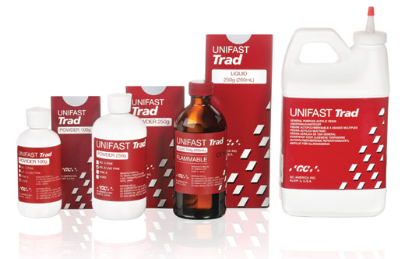
Old-school dental acrylic, aka “grip cement”
Recommend Unifast Trad
Hardens into plastic that is very strong. Moderate adhesive strength, high cohesive strength. Rapid curing to full strength. Usually translucent but opaque available.
Mix powder and liquid (add with disposable dropper) in silicone cup. With practice, can mix different ratios for thick/thin. If mixed thick, cures more rapidly. To extend working time, intentionally mix too thin and keep stirring until viscosity is in correct range. Thin mixing slightly worsens polymerization shrinkage.
Can be removed by soaking in chloroform with water layered on top (to prevent chloroform evaporation). Can be melted and reshaped with soldering iron.
Cons: liquid contains methylmethacrylate monomer. Strong odor before it has cured, toxic if applied directly to brain tissue.

Slide 57
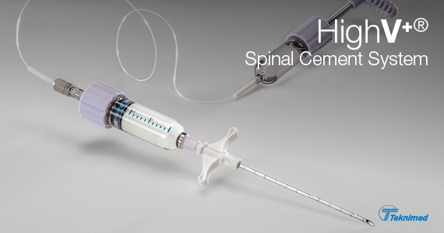
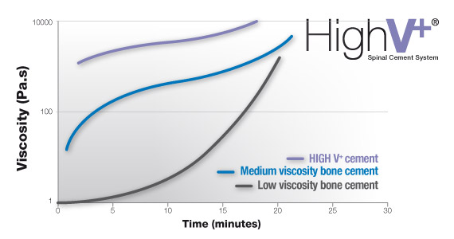
Original application of dental acrylic: “bone cement”

Slide 58
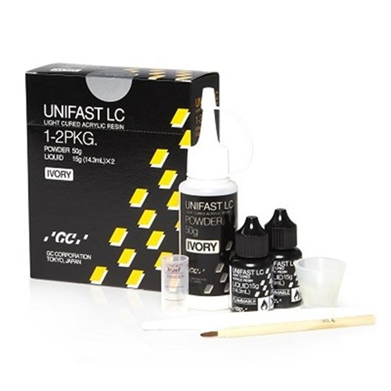
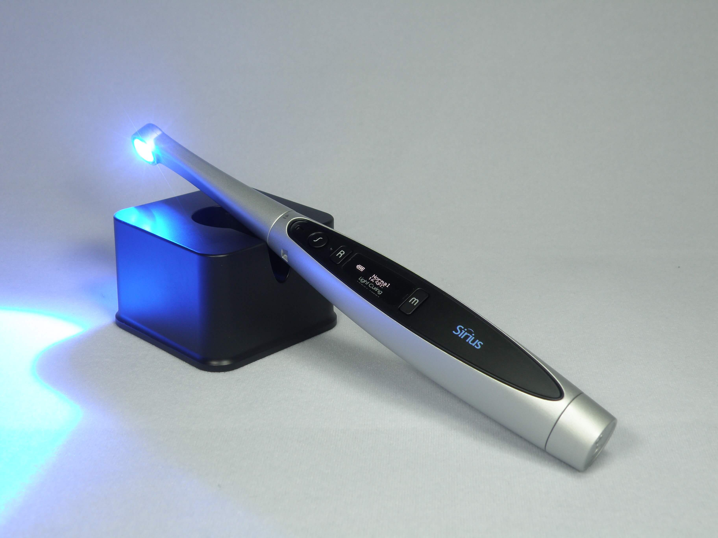
Visible Light Curing (VLC): blue light, ~470 nm
Blue light curing vs. UV curing: UV curing no longer used in dentistry
UV curing: still used for optical applications, e.g. coupling optical fibers to a laser diode (Thorlabs Norland cement)
Unifast LC: light-curable dental acrylic. Similar properties to other powder/liquid dental acrylic but stickier and a little harder to work with

Slide 59
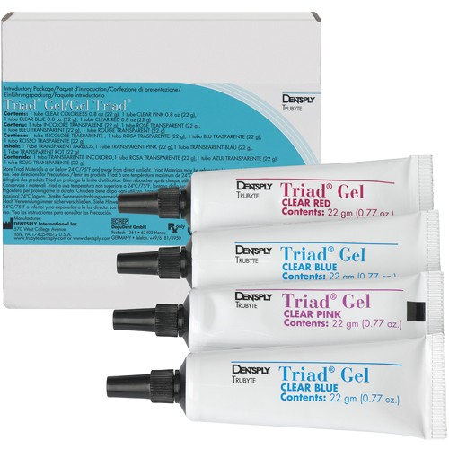
Recommended light-curable dental acrylic: Triad Gel
Used to make/repair dental appliances (e.g. retainers)
Easier to work with than traditional dental acrylic: premixed at perfect thickness, minimal odor, nontoxic, near-infinite working time under normal room light, cures in ~5 seconds under blue light wand
High cohesive strength, lower adhesive strength than traditional acrylic, slightly more brittle
Transparent, comes in several colors

Slide 60
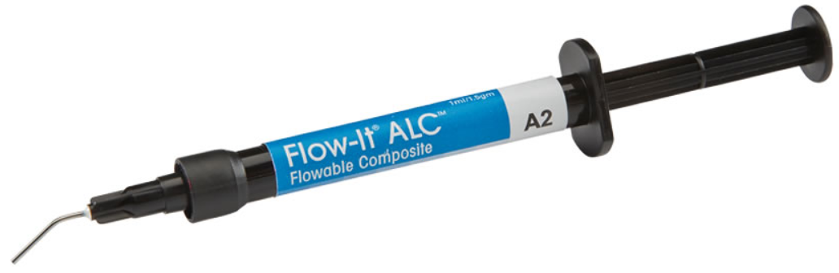
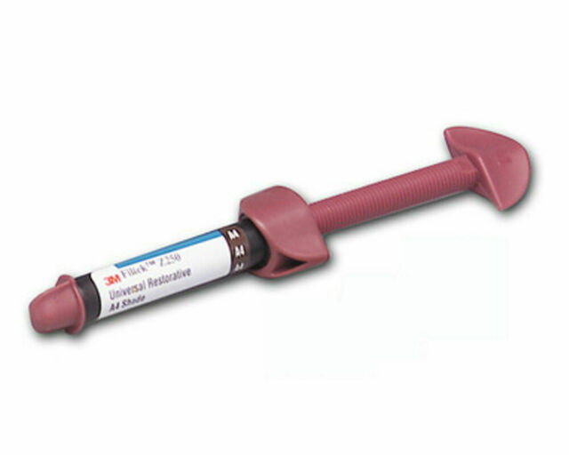
LC composite resins: dental filling material
Flowable: Flow-it ALC
Comes in convenient syringe applicator. Very easy to use
Can substitute for Triad Gel
Non-flowable: Filtek Z250
More putty-like texture

Slide 61
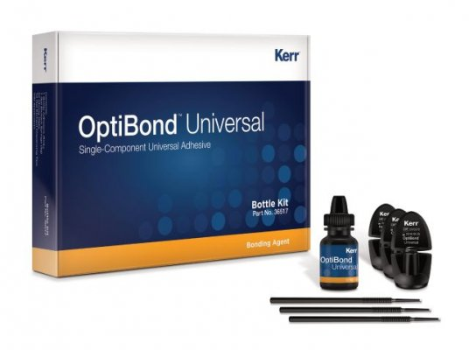
For attachment to bone: dental luting cement
Luting cement: designed to act as a layer between two dissimilar materials to bond them together (e.g. tooth and filling material). Adheres strongly to skull, providing a base layer on which to apply other adhesives
Recommend OptiBond Universal: cures on exposure to blue light
Very thin, use two layers on skull (paint, cure, paint, cure)
Many labs still use C&B Metabond, but this is faster and easier

Slide 62

Biophysics of fluorescence and photobleaching
https://micro.magnet.fsu.edu/primer/java/jablonski/jabintro/jablonskijavafigure1.jpg

